Slide 1

ECEN 461
Real-Time and Embedded Systems
IOT – Information - Spectrum Representation

Slide 2
Agenda
Prayer/Thought
Sinusoidal Signal Review
Spectrum Representation
Spectrum of Sum of Sinusoids
Periodic Waveforms
Harmonic Signals

Slide 3
Cool New Technology
http://www.ocztechnology.com/products/ocz_peripherals/nia-neural_impulse_actuator
This uses DSP to read in the sensor signals and then interpret them into gaming signals

Slide 4
Questions on HW/Lab?
HW 1 due EOD
Lab 1 due EOD tomorrow
HW 2 is posted and due 1.5 weeks
Longer assignment, so start early

Slide 5
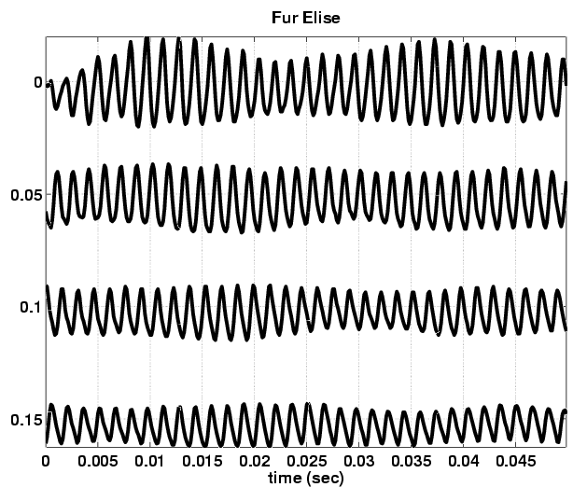
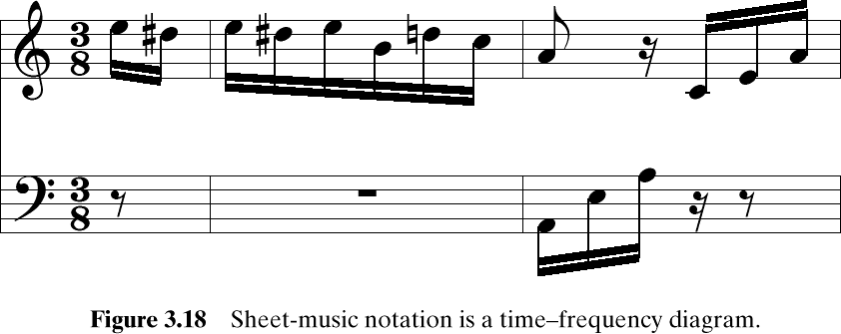
Fur Elise Waveform

Slide 6
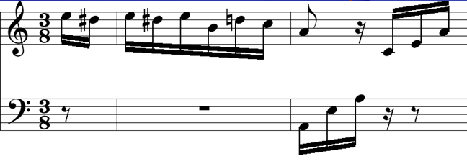
What does this represent?
A-440 Hz
Frequency is the vertical axis
Time is the horizontal axis
This is a Time-Frequency Diagram – One form of a Spectrum Diagram

Slide 7
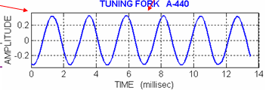
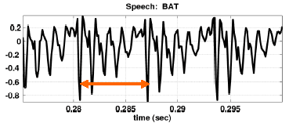
Sinusoidal Signals
Tuning Fork – Very Periodic
Bat Signal – Kinda Periodic in Vowel Region
If we wanted to plot the tuning fork using a frequency diagram, how could we do it?
Amplitude/freq plot

Slide 8
Sinusoidal Signals
Tuning Fork – Periodic Signal
A
0
880π
ω
This is another frequency diagram
Amplitude/Frequency diagram
Snapshot in time

Slide 9
“Bat” Signal
How about “Bat”, what would it look like?
A
0
40000π
ω
Amplitude/Frequency diagram
Snapshot in time
These diagrams are very useful for analyzing a signal

Slide 10
Euler’s Formula
What was Eulers Formula?
Complex Exponential
Real part is cosine
Imaginary part is sine

Slide 11
Inverse Euler Formulas
Sine’s or Cosine’s can be represented as complex exponentials
Derivation is shown in appendix

Slide 12
Exponential Representation
Cosine = sum of 2 complex exponentials:
One has a positive frequency
The other has negative freq
Amplitude of each is half as big

Slide 13
2 Sided Spectrum Representation
-7
0
7
ω
Amplitude, Phase & Frequency are shown

Slide 14
Exponential Representation
Sine = sum of 2 complex exponentials:
Asin(7t) = ?
Positive freq. has phase = -0.5π
Negative freq. has phase = +0.5π

Slide 15
Graphical Spectrum
-7
0
7
ω
Amplitude, Phase & Frequency are shown

Slide 16
Defn: Spectrum
A compact representation of the amplitude, phase, and frequency content of a signal that is composed of sinusoids
–f₂
–f₁
0
f₁
f₂
f (in Hz)

Slide 17
Example Spectrum
–250
–100
0
100
250
f (in Hz)
What is the formula for the signal x(t)?

Slide 18
–250
–100
0
100
250
Frequencies:
-250 Hz
-100 Hz
0 Hz
100 Hz
250 Hz
Amplitude & Phase
4 -π/2
7 +π/3
10 0
7 -π/3
4 +π/2

Slide 19
–250
–100
0
100
250
Use Euler’s Formula to get REAL sinusoids:

Slide 20
Final Answer
general form:

Slide 21
Why look at the Frequency Spectrum?
Synthesize Complicated Signals
Musical Notes
Chords: play several notes simultaneously
Human Speech
Vowels have dominant frequencies
Application: computer generated speech
Can all signals be generated this way?
Sum of sinusoids?

Slide 22
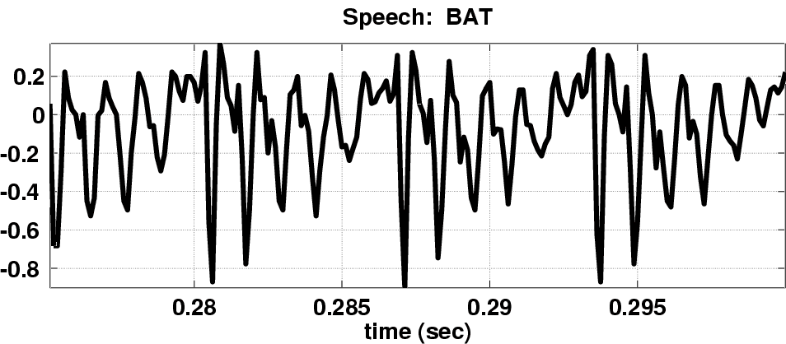
Speech Signal: BAT
Nearly Periodic in Vowel Region
Period is (Approximately) T = 0.0065 sec

Slide 23
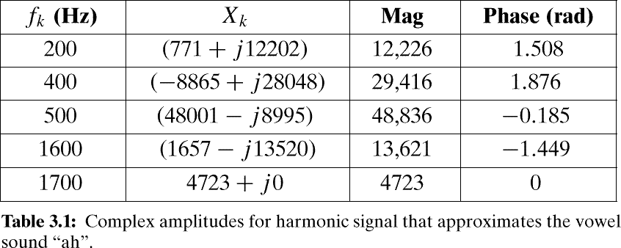
Example: Synthetic Vowel
Sum of 5 Frequency Components

Slide 24
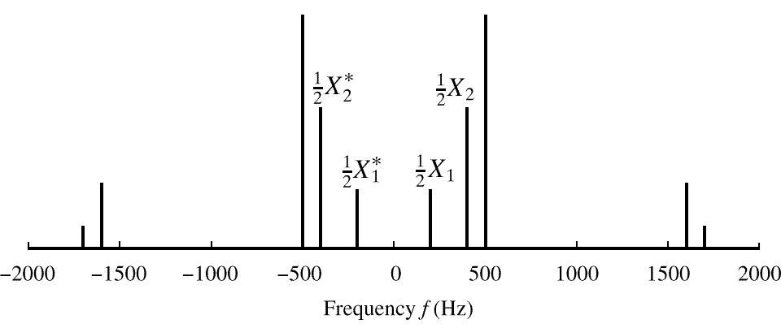
Spectrum of Vowel
Note: Spectrum has 0.5X_{k} (except X_{DC})
Conjugates in negative frequency

Slide 25
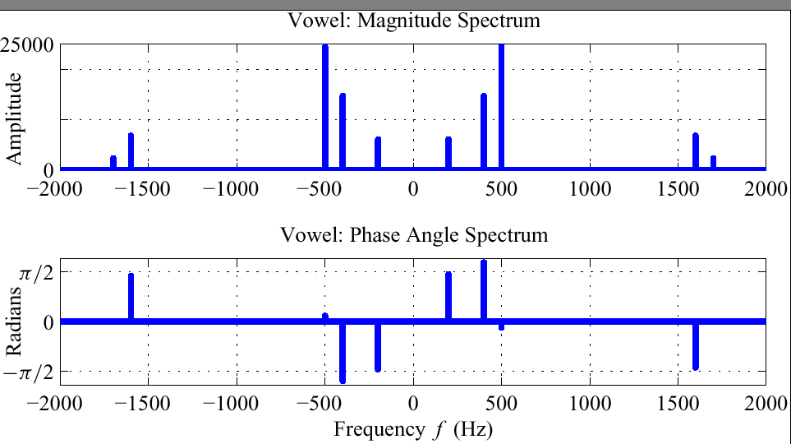
Spectrum of Vowel (Polar Format)
0.5A_{k}
φ_{k}

Slide 26
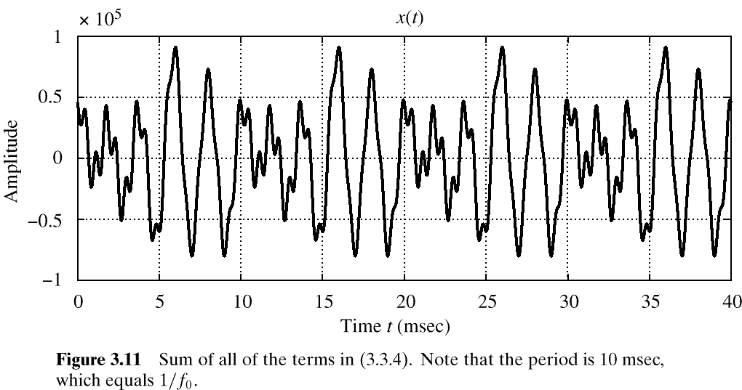
Vowel Waveform (sum of all 5 components)

Slide 27
Backup

Slide 28
Demo
Simple and Complex Spectrum Demo’s on CD
&&& Lecture went 45 min. Try to synthesize something like the aaah
See backup slides

Slide 29
What is a Periodic Signal?
Repeat every T secs
Definition
Example:
Speech can be “quasi-periodic”

Slide 30
What is a Harmonic Signal?

Slide 31
Fundamental Frequency

Slide 32
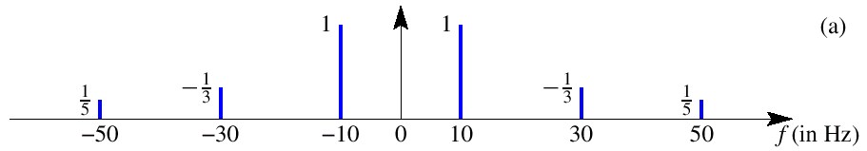
Harmonic Signal (3 Freqs)
3rd
5th
What is the fundamental frequency?
10 Hz

Slide 33
Another Example
Here’s another spectrum:
–250
–100
0
100
250
f (in Hz)
What is the fundamental frequency?
100 Hz ?
50 Hz ?

Slide 34
Fourier Theory
Fourier Theory tells us that any periodic signal x(t) can be represented by a sum of sinusoids
Anyone remember Fourier’s equation?

Slide 35
Summary: General Form’s

Slide 36
Euler’s Formula Reversed
Solve for cosine (or sine)

Slide 37
Another Freq Diagram
Plot Complex Amplitude vs. Freq
–250
–100
0
100
250
f (in Hz)
This is a Amplitude-Frequency Diagram

Slide 38

Negative Frequency???
Is negative frequency real?
The Doppler Effect provides an example
Train whistle passing
Let’s assume 400Hz ←→60 mph
+400Hz means towards the listener
-400Hz means away (opposite direction)

